Slide 1
Energy of Wind in Germany and Poland
Felipe Gastaldi, Changhong Guan, Andrew McAlister, Swathi Mohandas Naik, Kerri Robinson

Slide 2

Overview
Problem: Analyzing historical alternative energy trends with the most advanced European countries, how can we project future alternative energy adoption for less sophisticated European nations, and how key energy companies might financially benefit from their adoption?
Hypothesis: Our hypothesis is the wind turbine market sector will experience accelerated exponential growth in the next few years. We will provide revenue growth predictions for two companies – Vestas and Gamesa. We have also filtered the stock data to focus specifically on those companies.

Slide 3
Data
Topics
Energy related (electricity production/consumption, wind energy and weather conditions)
Historical stock data for the companies under consideration (VESTAS and SIEMENS GAMESA) and their key performance indicators from the financial reports.
Cleaning
New Additions
Capacity of wind production Germany and Poland can maintain.
Germany has a 2% target capacity.
Currently Poland has a .3% cap due to legal frameworks. However, we will assume that they will adopt to other European countries and exhibit a 2% target to match Germany.
Data cleaning has been mostly completed but we are constantly refining our data and looking for energy factors that are not correlated such that we can use them to enhance our analysis

Slide 4
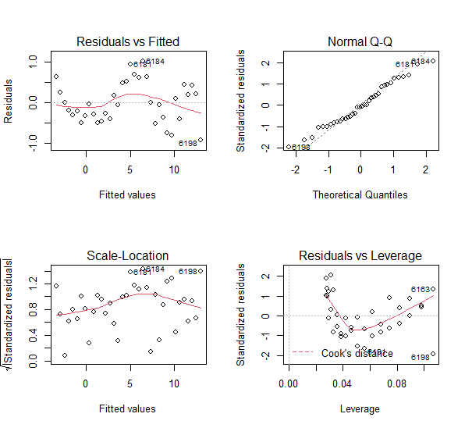
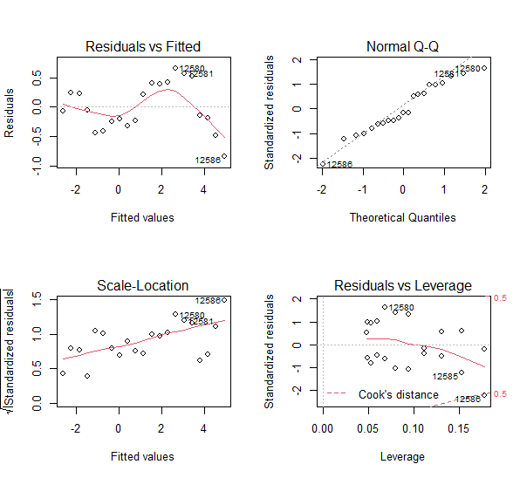
Approach
Germany SLR Poland SLR
Simple Linear Regression
As seen on the Germany residuals vs fitted chart, the errors show an "S-shaped" pattern, meaning our assumptions did not hold
Time Series
More conservative than SLR
Limited data to forecast beyond sample period
Need to set wind energy caps

Slide 5
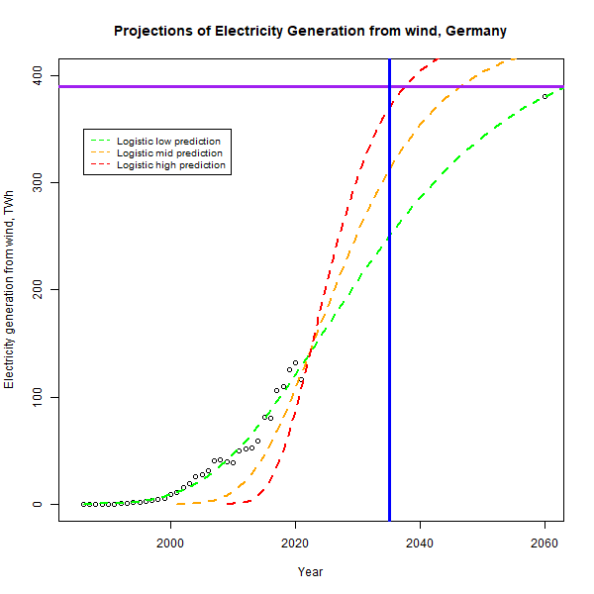
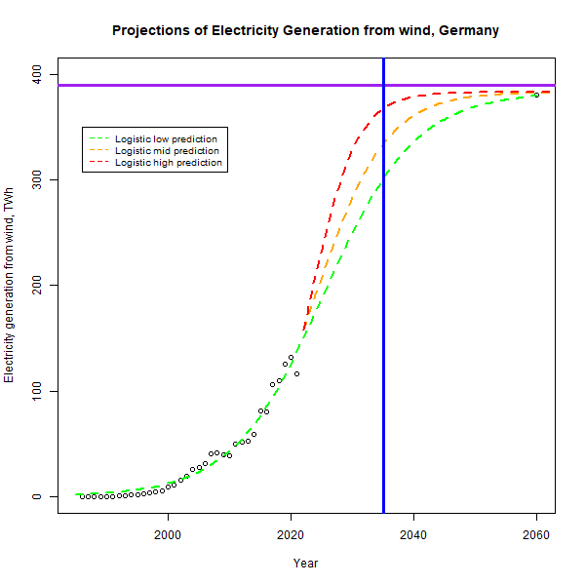

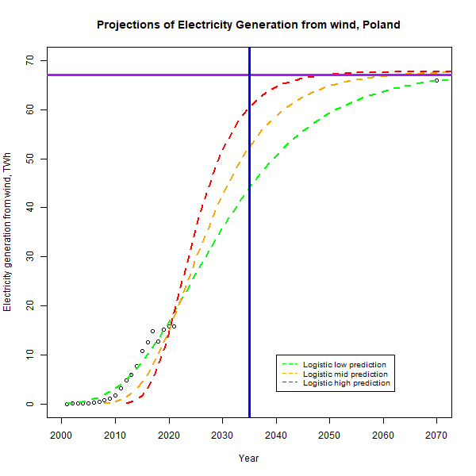
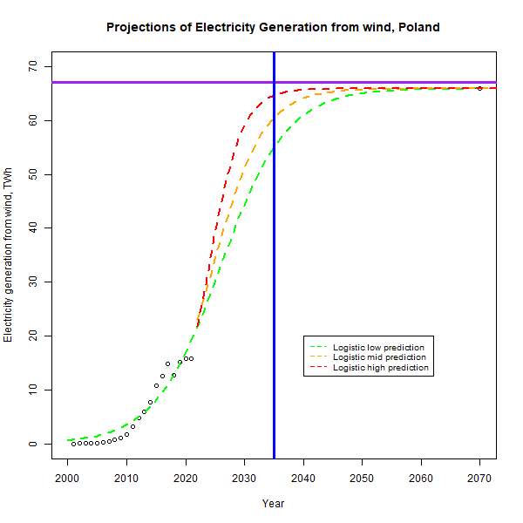

Approach
Germany Gompertz Poland Gompertz
Gompertz:
Used in modeling dynamics of tumor growth
The challenging part of using this model is that the dataset we have only covers less than first half of the curve, and we are trying to use a fitted model to predict majority rest in the future
Upper limit is no longer capped by our research number
Logistic Regression:
Germany Logistic Poland Logistic

Slide 6
Progress Updates
Significant progress has been made to generate models for both historical and potential future adoption of wind energy for both Germany and Poland
Investigated alternate modeling approaches (Time Series, Gompertz, Logisitic Regression) to address challenges with original Simple Linear Regression Models.
Research has been made to determine a realistic capacity cap for Germany and Poland

Slide 7
Challenges
Problems with initial Simple Linear Regression models led to further research and investigation of other modeling approaches.

Slide 8
Literature Review
Focused on determining maximum realistic wind energy capacity for our target countries
Wind energy capacity can be simplified down to available land.
Limited approach to onshore wind capacity only.
Based on a study “Potenzial der Windenergienutzung an Land” (2011) by the German Wind Energy Association (BWE) and further analyzed by Beckius and Magnusson (2013) it has been estimated that a realistic target for the total wind energy output of Germany would utilize a footprint equivalent to about 2% of German land area or a 189 GW capacity.
In a study by Ember Coal to Clean (Czyzak 2022) they determined that Poland currently can use only 0.3% of their total land for wind turbines due to current policies around turbine distancing. They estimated this capped their max capacity at 10 GW.
For the purposes of our analysis, we will assume that Poland will adopt a similar policy to other European countries and can reach a similar 2% target we set for Germany which is roughly 67 GW.
Notes:
When creating future wind energy projections for our target countries it is critical that we consider the maximum amount of wind energy each country can produce
Wind energy this can be simplified down to available land. For the purposes of this analysis, we will limit our scope to onshore wind and ignore offshore wind capacity limits.
Based on a study “Potenzial der Windenergienutzung an Land” (2011) by the German Wind Energy Association (BWE) and further analyzed by Beckius and Magnusson (2013) it has been estimated that a realistic target for the total wind energy output of Germany would utilize a footprint equivalent to about 2% of German land area.
The 2% target equates to an estimated 189 GW capacity potential. While this capacity target may end up smaller than reality due to advancements in turbine technology or other factors, for the purposes of this project we will set the 189 GW capacity estimate as our cap for future energy potential.
In a study by Ember Coal to Clean (Czyzak 2022) they determined that Poland currently can use only 0.3% of their total land for wind turbines due to current policies around turbine distancing. They estimated this capped their max capacity at 10 GW.
Since the 0.3% cap is largely due to legal frameworks and not technical or landscape constraints for the purposes of our analysis we will assume that Poland will adopt a similar policy to other European countries and can reach a similar 2% target we set for Germany. If we extrapolate from the 10GW estimate for .3% land use for Poland a 2% land use would place Poland total capacity target at ~67 GW.

Slide 9
Works Cited
Beckius, D., & Magnusson, D. (2013). The German wind energy market and its developers – a study of sourcing models, success factors and challenges. http://www.diva-portal.org/smash/get/diva2:644677/FULLTEXT01.pdf
Umwelt Bundes Amt (UBA) (2013), Potenzial der Windenergie an Land. https://www.wind-energie.de/fileadmin/redaktion/dokumente/publikationen-oeffentlich/themen/01-mensch-und-umwelt/03-naturschutz/bwe_potenzialstudie_kurzfassung_2012-03.pdf
Czyzak, P. (2022). Change is in the Wind. https://ember-climate.org/app/uploads/2022/03/Briefing_-Unlocking-onshore-wind-in-Poland.pdf
Rafael Lahoz-Beltra, Gompertz Function with R. https://encyclopedia.pub/entry/626

